Slide 1

DATA STRUCTURES AND ALGORITHMS (113215)
Dr. Owais Hussain

Slide 2

Agenda
Stack
Memory representation
Stack Operations
Complexity Analysis
In real life

Slide 3
Sample 2
Stack
An Abstract Data Type which works on the principles of LIFO (Last-In-First-Out).
It can be constructed using an Array as well as Linked List.
A stack allows only 5 operations:
Push: which is another name for Insert at the end of the list.
Pop: fetches the top element and removes from the list.
Peek: fetches the top element but does not remove it.
Is Empty: checks if the Stack has any elements.
Destroy or Clear: removes the elements and frees up the memory.

Slide 4
Sample 2
Memory representation – In Array
After Pushing first element
After Pushing 3 more elements
After Popping the Top element
Top
Top
Shahzaman
Index: 3
2240
Mohimin
Index: 2
Mohimin
Index: 2
2240
Top
Asra
Index: 1
Asra
Index: 1
Hafs
Index: 0
2000
Hafs
Index: 0
2000
Hafs
Index: 0
2000

Slide 5
Sample 2
Memory representation – In Linked List
In case of Linked List, nothing changes except that instead of index, each node has a pointer which links to previous node.
The addressing is also dynamic.
Top
Shahzaman
Address: 4050
Mohimin
Address: 3340
Asra
Address: 2080
Hafs
Address: 2000

Slide 6
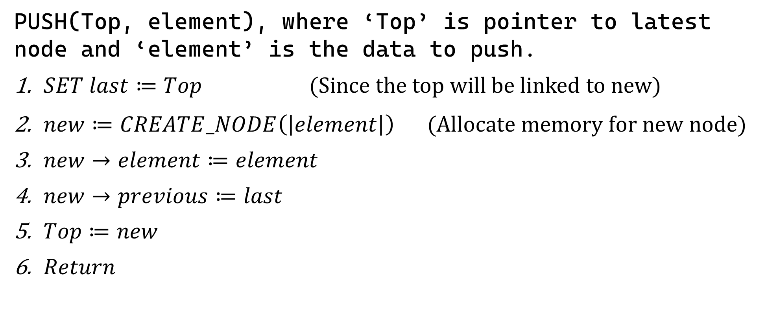
Sample 2
Stack Operations
PUSH(Top, element), where ‘Top’ is pointer to latest node and ‘element’ is the data to push.
$SET last≔Top$ (Since the top will be linked to new)
$new≔CREATE_NODE\left(\left|element\right|\right)$ $\text{ (}\text{Allocate} \text{memory} \text{for} \text{new} \text{node}\text{)}$
$new→element≔element$
$new→previous≔last$
$Top≔new$
$Return$

Slide 7
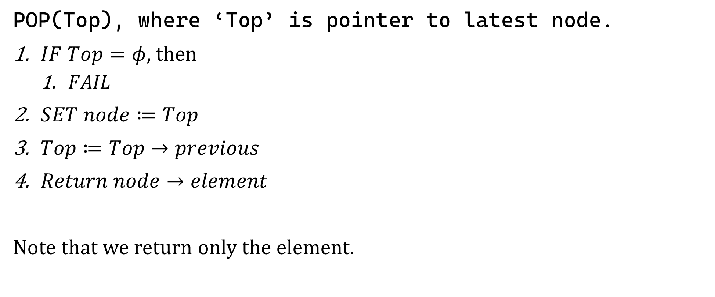
Sample 2
Stack Operations
POP(Top), where ‘Top’ is pointer to latest node.
$IF Top=φ$, then
$FAIL$
$SET node≔Top$
$Top≔Top→previous$
$Return node→element$
Note that we return only the element.

Slide 8

Sample 2
Stack Operations
PEEK(Top)
$IF Top=φ$, then
$FAIL$
$Return Top→element$
IS_EMPTY(Top)
$IF Top=φ$, then $Return$ $true$
$Return$ $false$
CLEAR(Top)
$REPEAT while Top≠φ$ $POP$ $(Top)$
$Return$

Slide 9
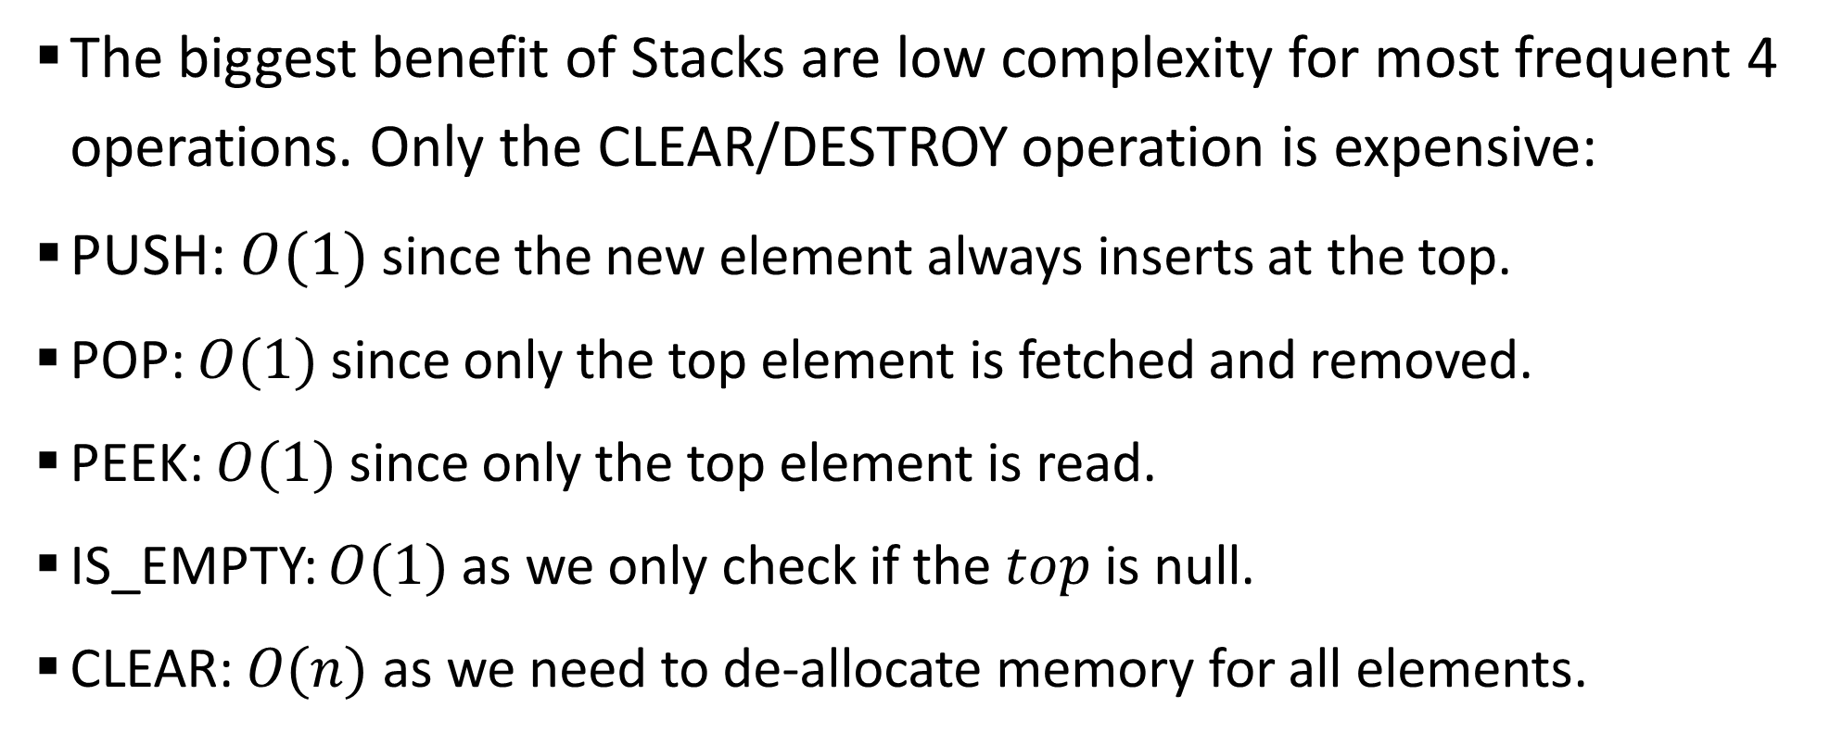
Sample 2
Complexity Analysis
The biggest benefit of Stacks are low complexity for most frequent 4 operations. Only the CLEAR/DESTROY operation is expensive:
PUSH: $O(1)$ since the new element always inserts at the top.
POP: $O(1)$ since only the top element is fetched and removed.
PEEK: $O(1)$ since only the top element is read.
IS_EMPTY: $O(1)$ as we only check if the $top$ is null.
CLEAR: $O(n)$ as we need to de-allocate memory for all elements.

Slide 10
Sample 2
In real life
The first and foremost is the LIFO principle.
Second consideration is Search. Stack does not offer a Search.
Third limitation is absence of Sort.
Considering the above 3, Stacks can be used smartly in a variety of cases.

Slide 11

Sample 2
In real life
Stacking Pizzas inside carrier for Food Panda riders.
If you Stack up the pizzas vertically, then little space is required for 6 to 12 orders.
The rider can unload only one pizza at a time; the best way would be to put the pizza of farthest customer first and nearest customer at the top.
Given, of course, that the rider also knows how to handle the job.

Slide 12
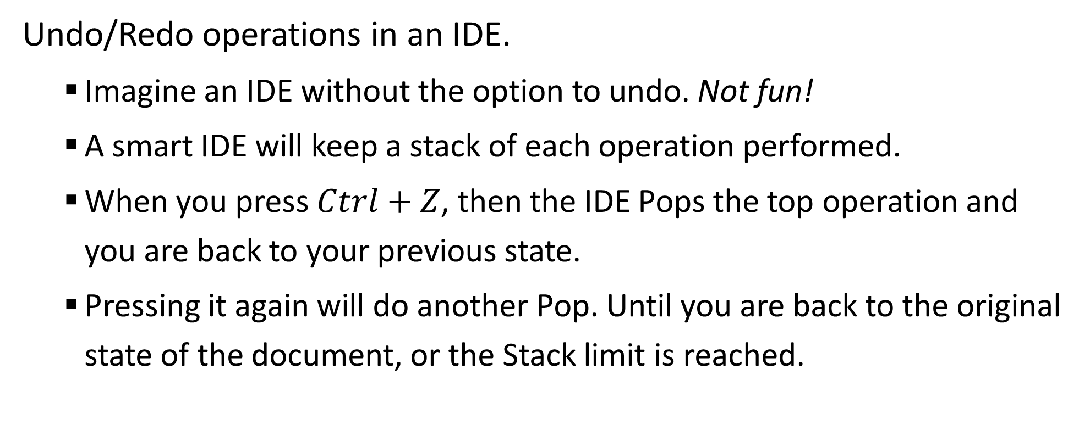
Sample 2
In real life
Undo/Redo operations in an IDE.
Imagine an IDE without the option to undo. Not fun!
A smart IDE will keep a stack of each operation performed.
When you press $Ctrl+Z$, then the IDE Pops the top operation and you are back to your previous state.
Pressing it again will do another Pop. Until you are back to the original state of the document, or the Stack limit is reached.

Slide 13
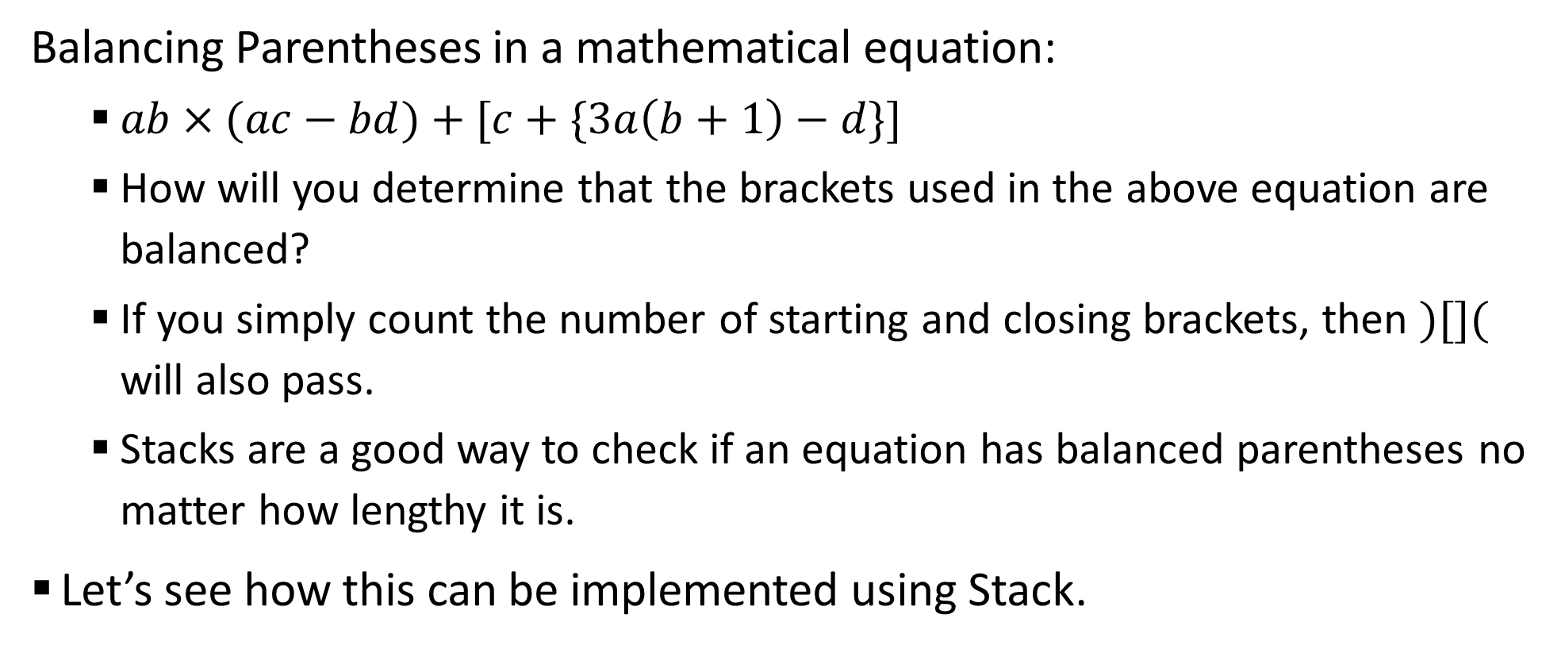
Sample 2
In real life
Balancing Parentheses in a mathematical equation:
$ab×(ac−bd)+[c+\{3a\left(b+1\right)−d\}]$
How will you determine that the brackets used in the above equation are balanced?
If you simply count the number of starting and closing brackets, then $)[]($ will also pass.
Stacks are a good way to check if an equation has balanced parentheses no matter how lengthy it is.
Let’s see how this can be implemented using Stack.

Slide 14
Sample 2
In real life
Initialize an empty stack.
Scan the equation from left to right.
If the character is opening: (, {, or [ then Push into the stack.
If the character is closing: ), }, or ] then Pop from stack. If the Pop fails or the stack is empty, then the equation is not balanced. Ignore all other characters.
If the Pop is successful, but the Popped element is not the starting character of current character, then the equation is not balanced.
If there are no more characters in the string and the stack is not empty, then the equation is not balanced.
Otherwise, the equation is balanced.

Slide 15
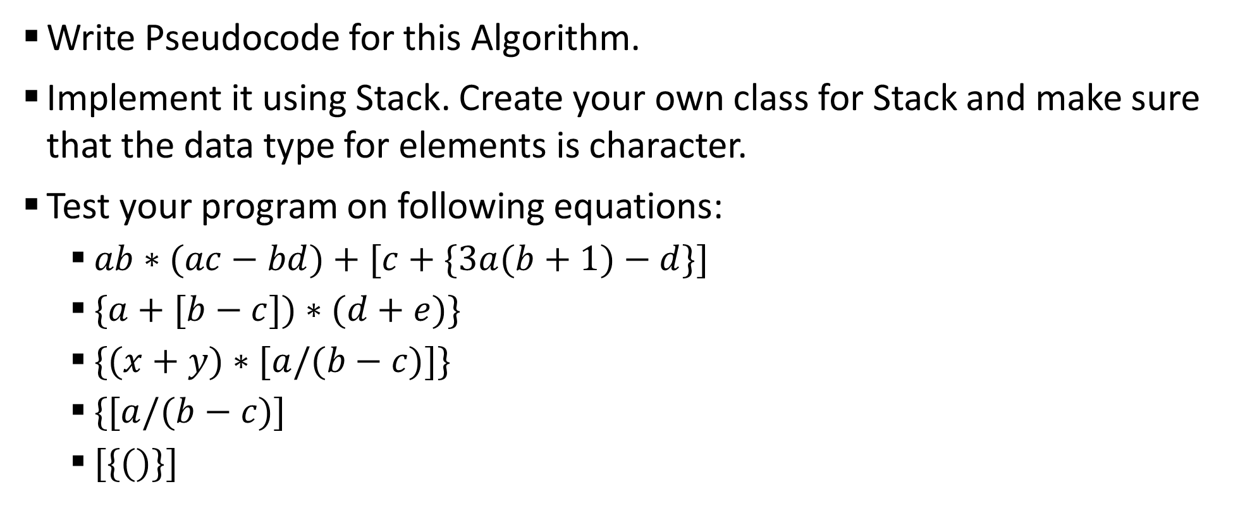
Sample 2
Exercise
Write Pseudocode for this Algorithm.
Implement it using Stack. Create your own class for Stack and make sure that the data type for elements is character.
Test your program on following equations:
$ab∗(ac−bd)+[c+\{3a(b+1)−d\}]$
$\{a+[b−c])∗(d+e)\}$
$\{(x+y)∗[a/(b−c)]\}$
$\{[a/(b−c)]$
$[\{()\}]$

Slide 16



THANK YOU
Owais Hussain
+92 345-3174270
owais.hussain@kiet.edu.pk
https://www.researchgate.net/profile/Owais-Hussain-3

